Slide 1
Project designs printed circuit board(PCB)
By Kone Laye Aziz

Slide 2

Table of Contents
SL.NO DESCRIPTION
Introduction
PCB design tools
Schematic
Types of PCB schemas
Discussion
Conclusion

Slide 3
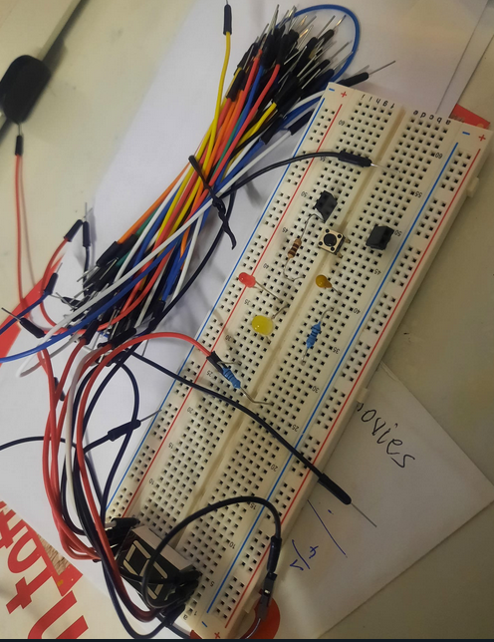
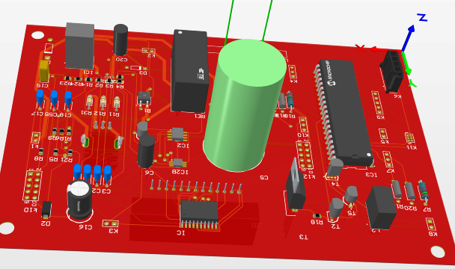
Introduction
Why PCB? Why not Breadboard?
Permanent project Rapid Prototyping project

Slide 4
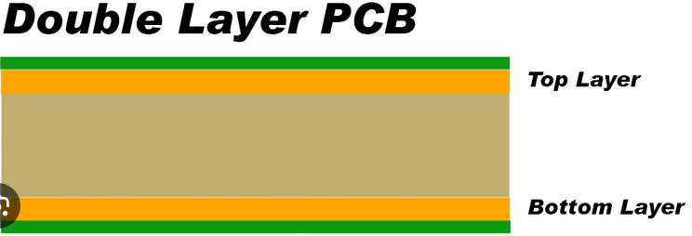
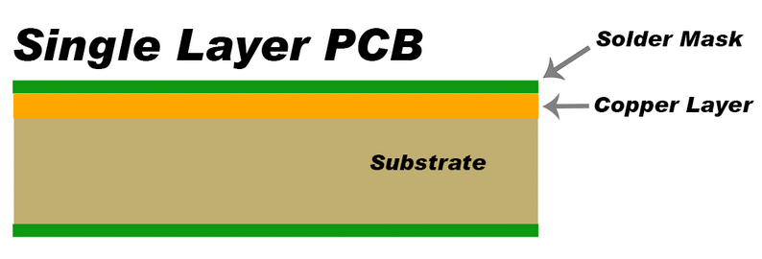
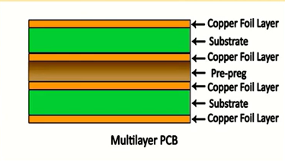
The three basic variants of PCB

Slide 5
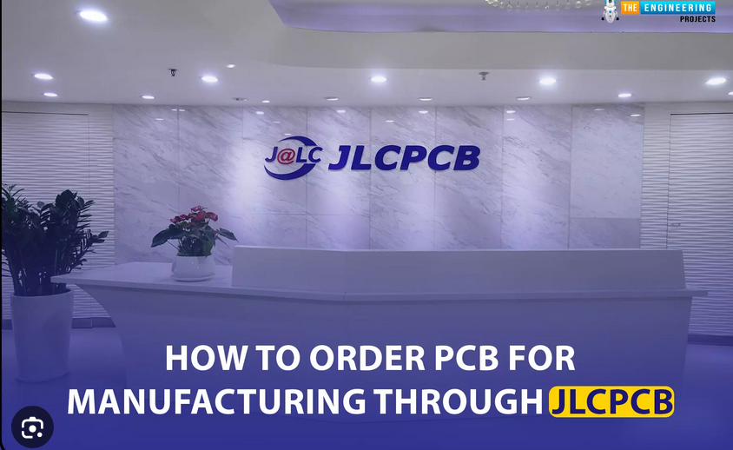


PCB Design Tool
JLCPPCB
Fusion360
Altium Designer - PCB Design Software

Slide 6
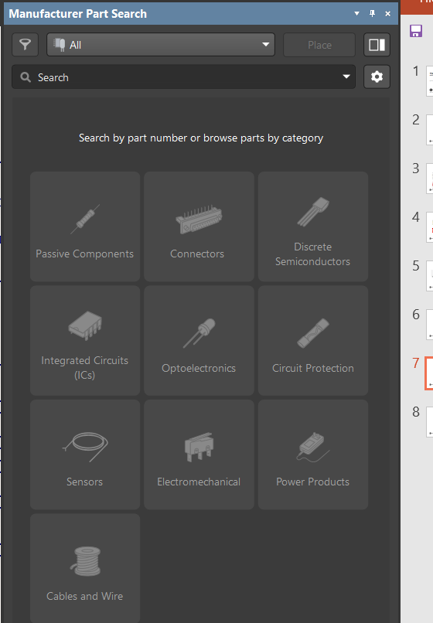
Discussion
Manufacture part search
Challenges for the project.
Finding some reference source.
Suggestions for improvement: pre-purchasing components, checking availability, accurate component calculation, creating a custom library
Manufacture is to find out the different components.

Slide 7
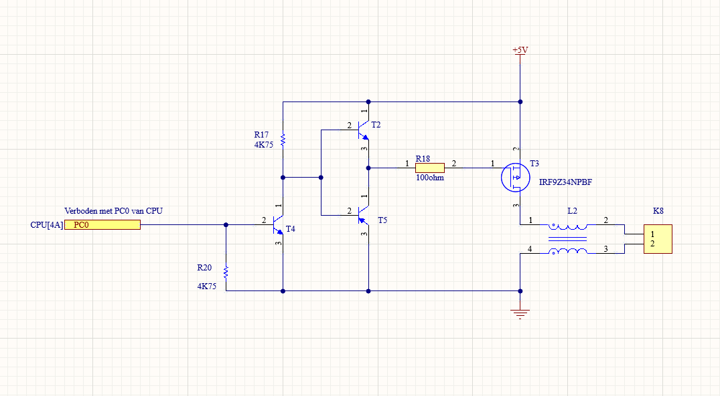
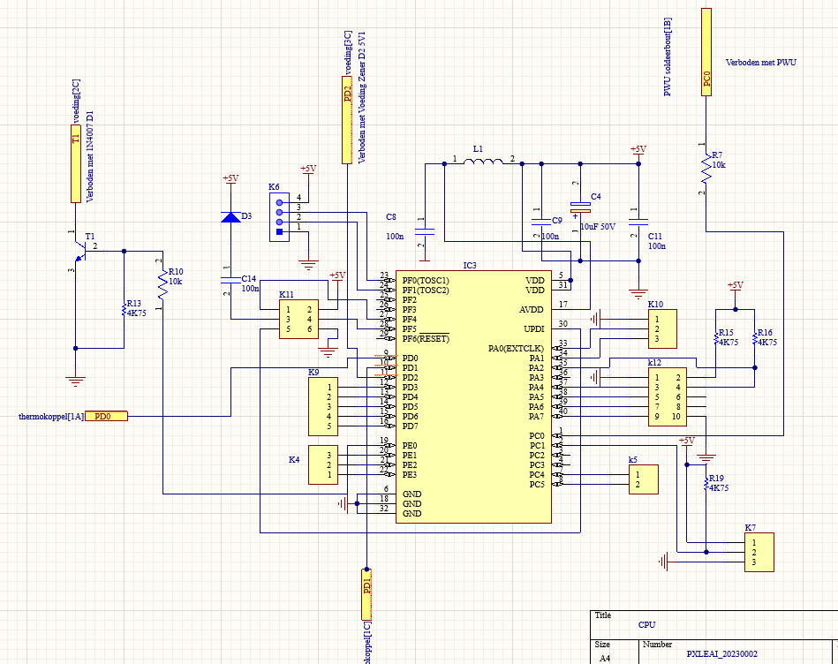
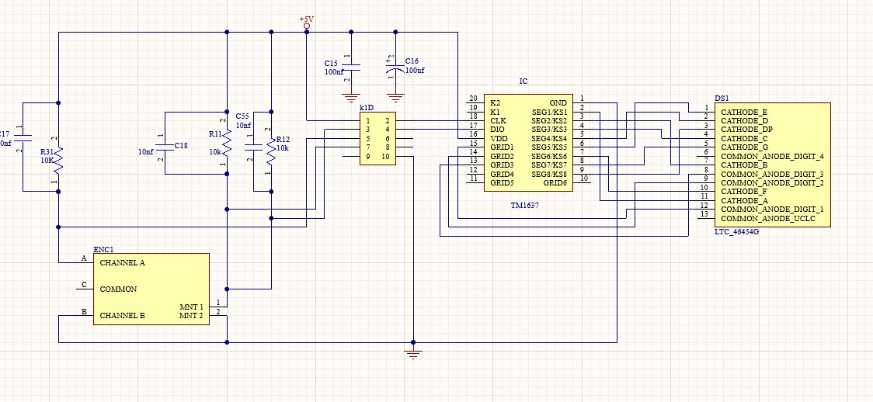
Types of PCB scheams
That is the five differents schema’s
PWU Schema (Power Unit):
CPU Schema:
DISPLAY Schema:

Slide 8
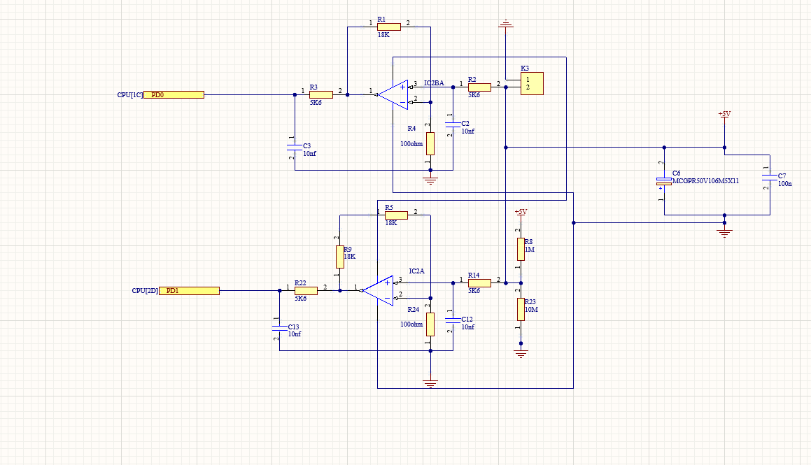
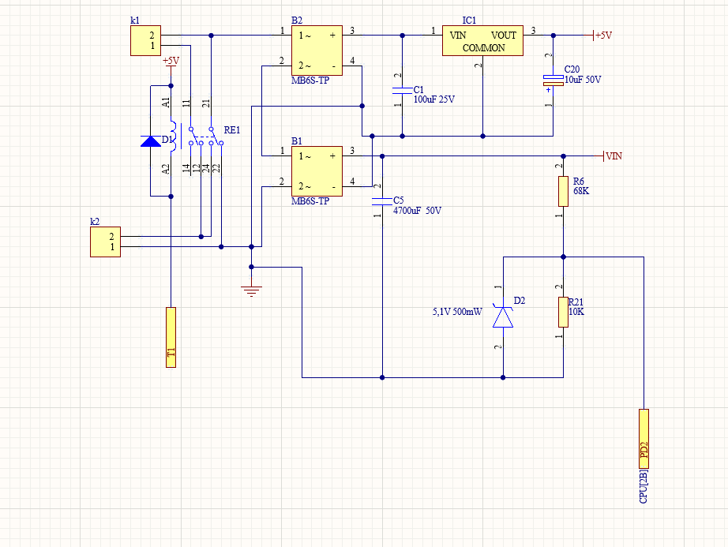
Thermocouple Schema:
Power Source Schema:

Slide 9
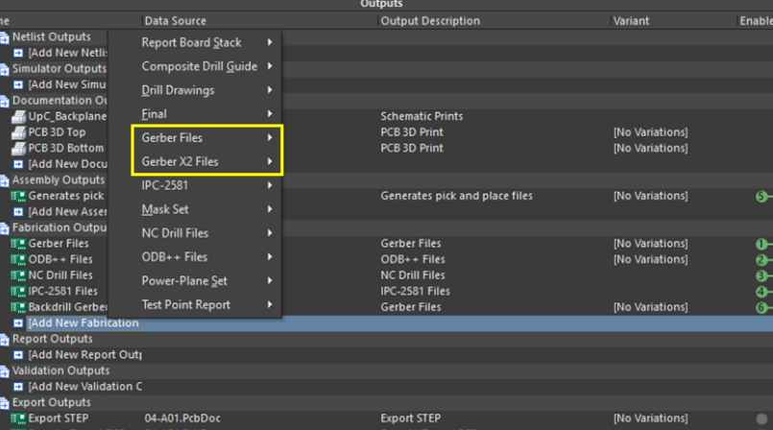
Getting Fabrication file
End Result
File → Fabricant output → Gerber file.

Slide 10
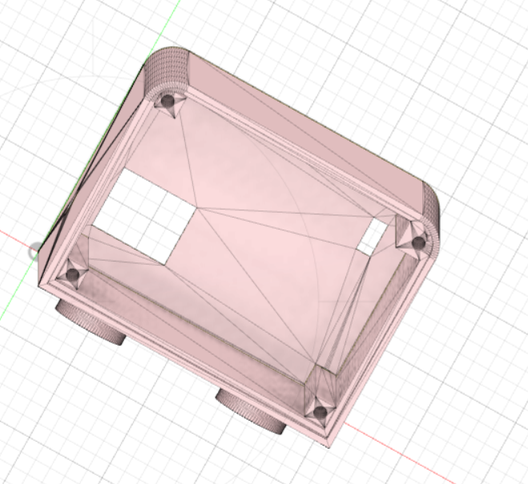
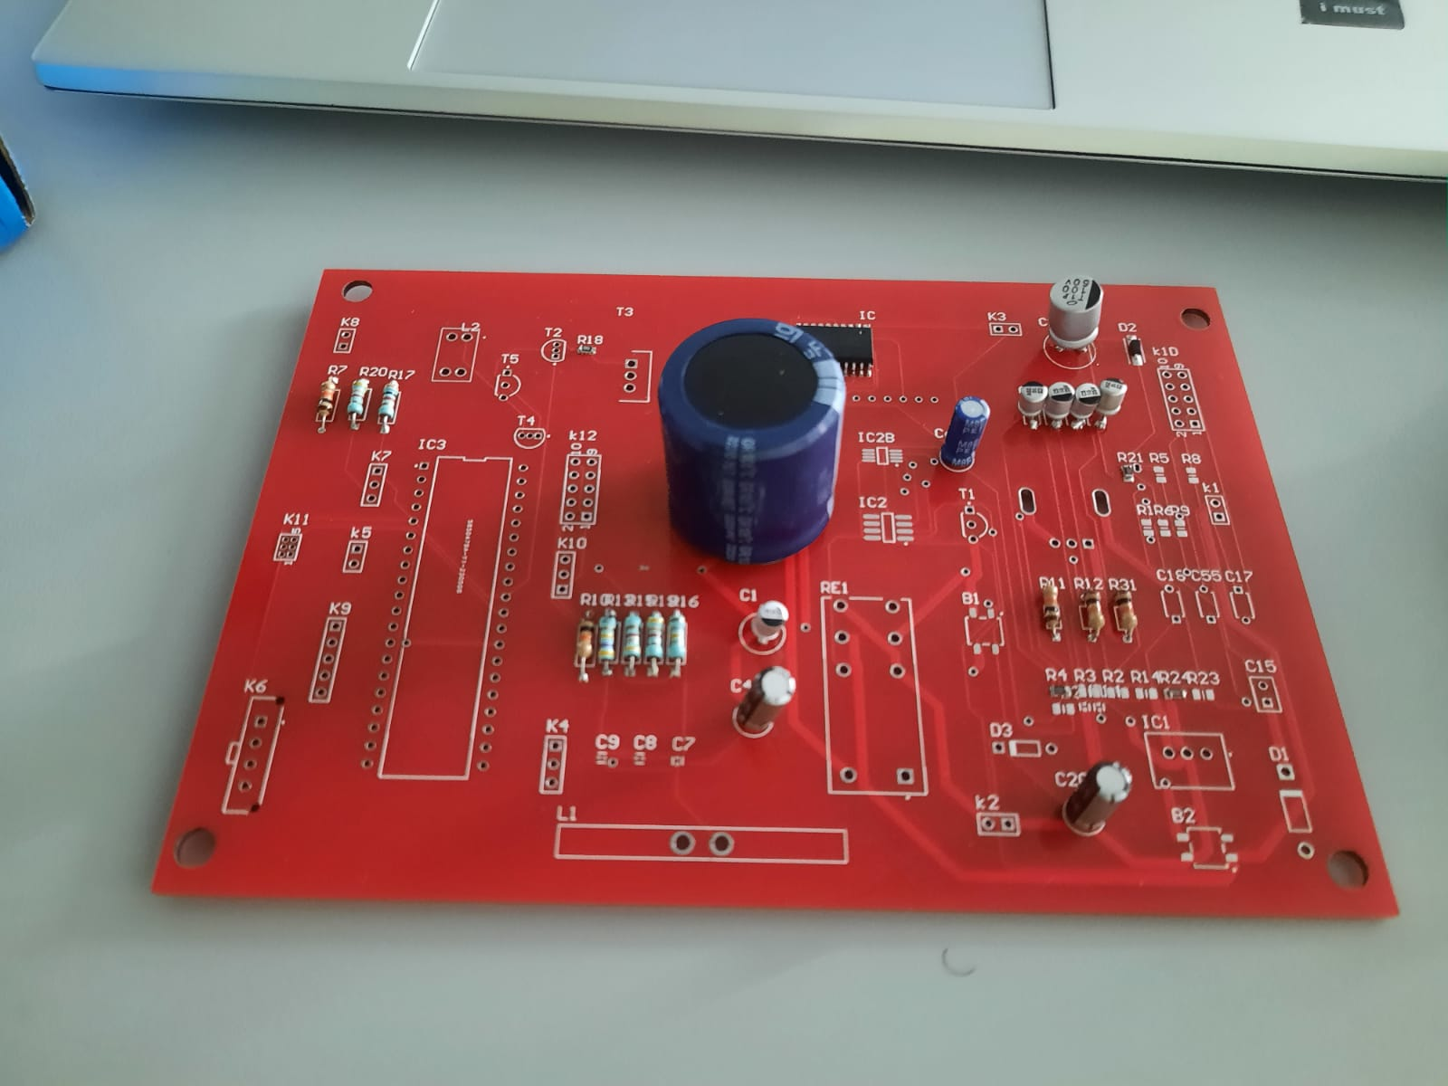
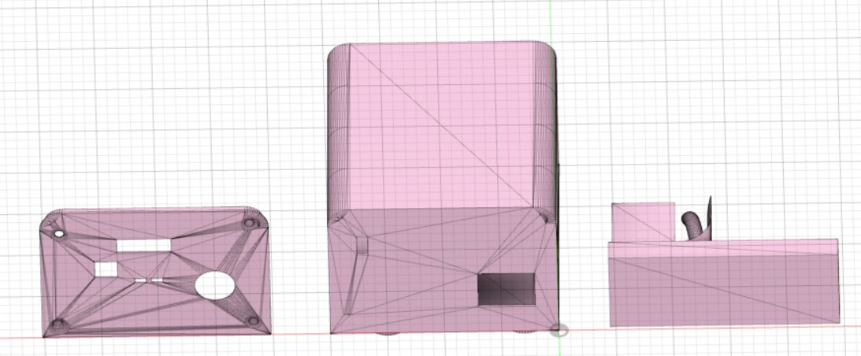
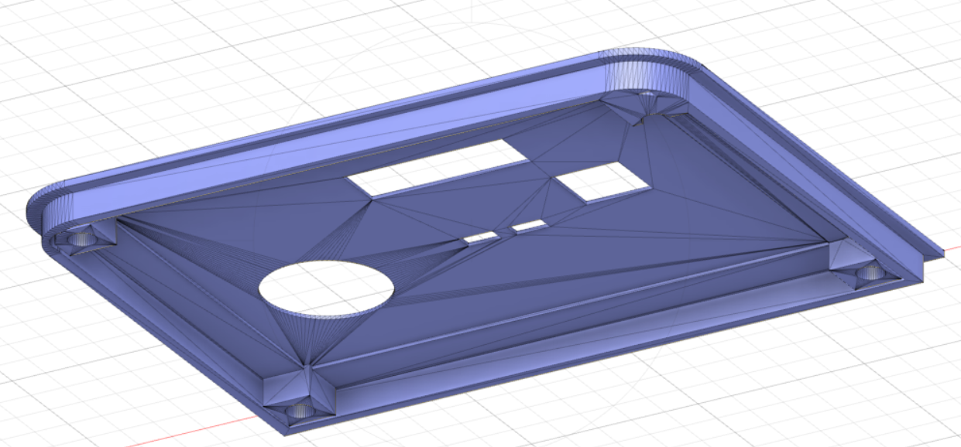
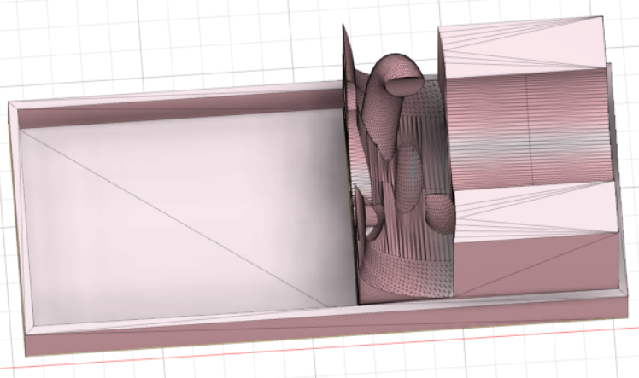
Conclusion
PCB physically
The case

